Slide 1
Recommender Systems
Using Python
Aug 12, 2016
Slides: https://goo.gl/ehBnhf
Notebook: https://github.com/dvysardana/RecommenderSystems_PyData_2016
Slides by Divya

Slide 2
Outline
Why Recommender Systems?
Examples of Recommender Systems
How to build a Recommender System?
Popularity based
Classification based
Collaborative Filtering
Nearest Neighbor
Matrix Factorization
4. Evaluation of Recommender Systems

Slide 3
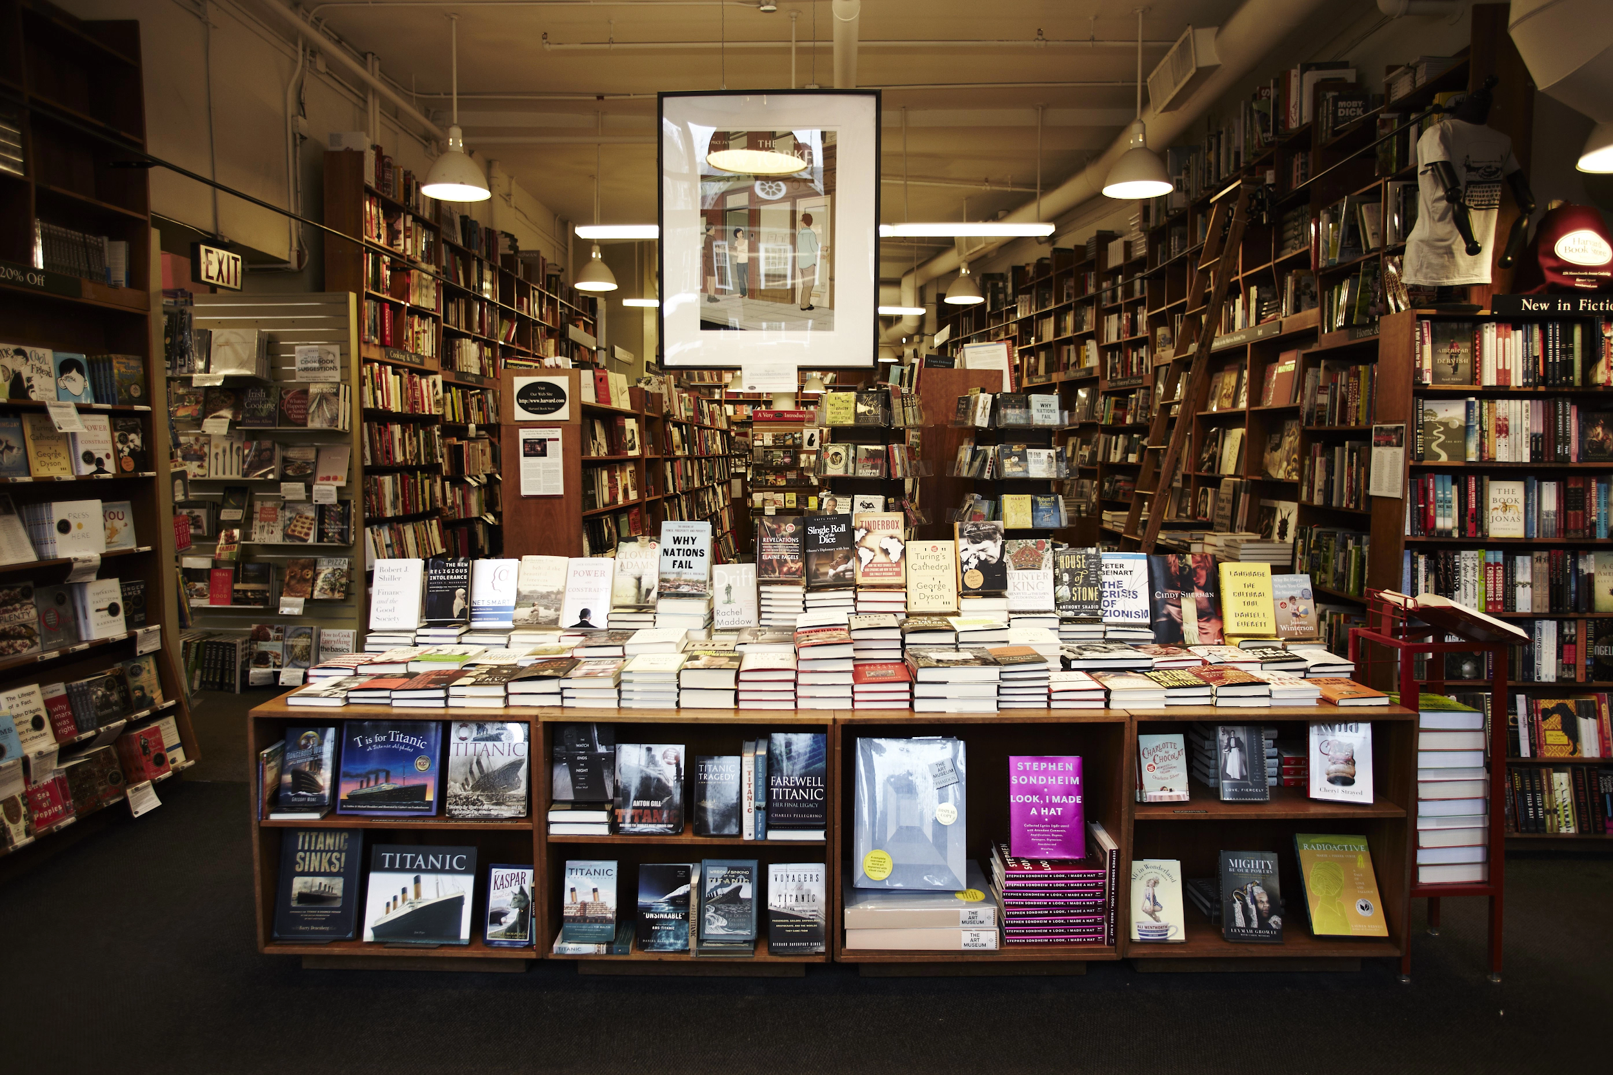
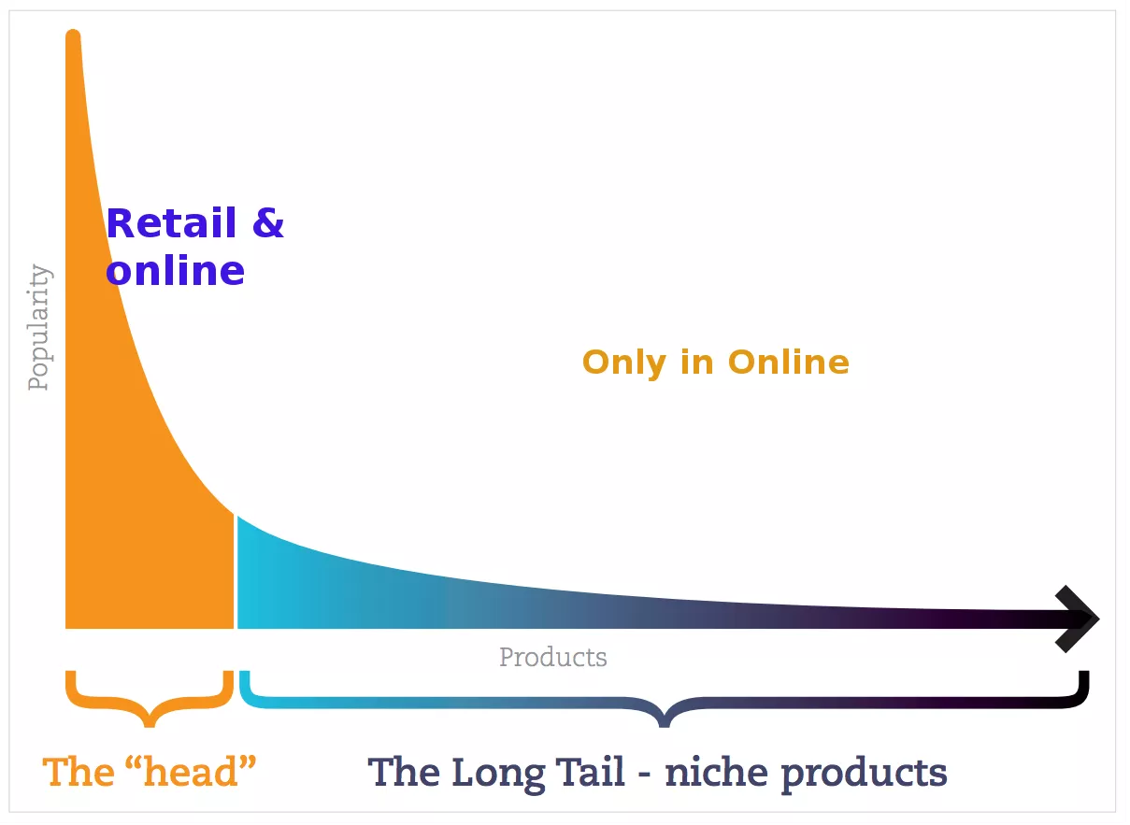

Why Recommender
Systems?
Goal of a Recommender System: Identify products most relevant to the user (Eg. Top n offers).
The long tail phenomenon
Notes:
Source: http://blogs.gartner.com/martin-kihn/how-to-build-a-recommender-system-in-python/
Relevance is at the heart of modern marketing. One-to-one relevance is the worry bead of all multichannel campaign management, mar-tech, ad-tech, mad-tech and digital marketing hub platforms. User-level personalization is where we all want to go and recommendation engines are one of the best early examples of how this can work.

Slide 4
2. Some Examples?

Slide 5

Movie/TV show Recommendations

Slide 6
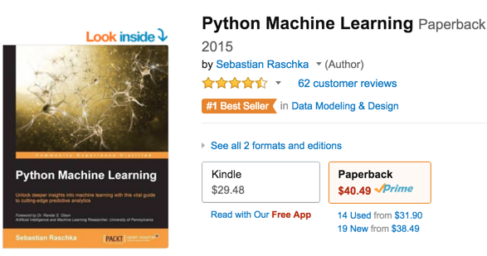
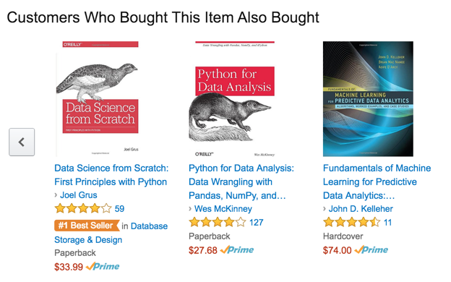
Product Recommendations

Slide 7

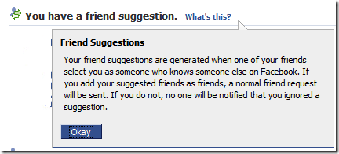
Friend Recommendations

Slide 8
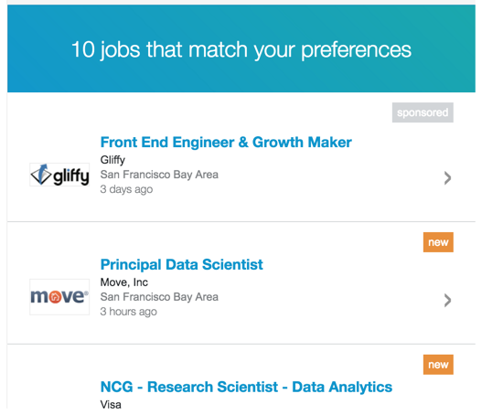

Job Recommendations

Slide 9

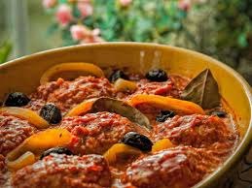

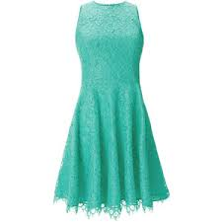
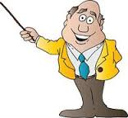
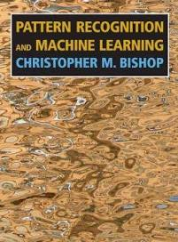
A Naive understanding of Recommender Systems
Users
Matching Items
Notes:
http://dataconomy.com/an-introduction-to-recommendation-engines/
A recommender system creates a matching between users and items and exploits the similarity between users/items to make recommendations. (Give examples of similarity) (Then go back in the slides.)

Slide 10


Quiz
What are users and matching items the following cases:
a.) LinkedIn
b.) Facebook
c.) Amazon
d.) Netflix
(Users: members, Items: jobs)
(Users: members, Items: members)
(Users: members, Items: products, e.g., books)
(Users: members, Items: movies, TV shows)

Slide 11


Power of Recommendations: A Success story
“In 1988, a British mountain climber named Joe Simpson wrote a book called Touching the Void, a harrowing account of near death in the Peruvian Andes. It got good reviews, only a modest success, it was soon forgotten. Then, a decade later, a strange thing happened. Jon Krakauer wrote Into Thin Air, another book about a mountain-climbing tragedy, which became a publishing sensation. Suddently, Touching the Void started to sell again.”...The Long Tail by Chris Anderson
Published in 1988
Published in 1996

Slide 12
3. Building a Recommender System

Slide 13
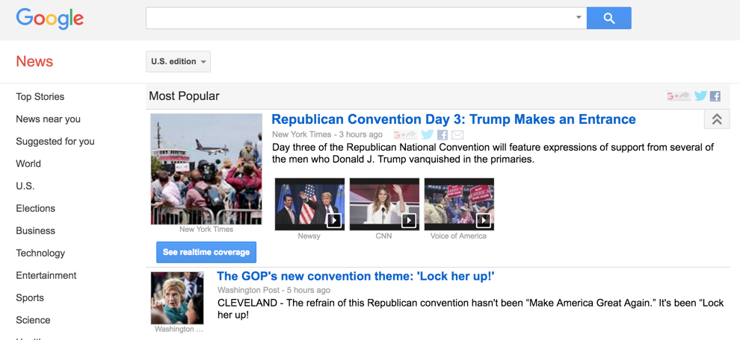
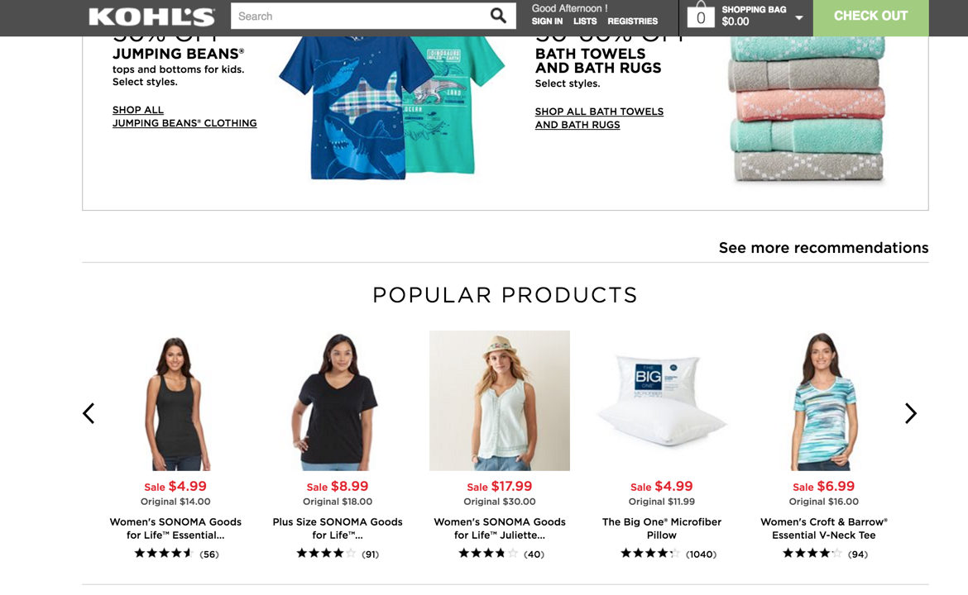
Solution 0: Popularity based Recommender System
Recommend items viewed/purchased by most people
Recommendations: Ranked list of items by their purchase count
Notes:
Even in a brick and mortar store, when we go to a book store...the best sellers, or the most popular items will be list first in line.
No. of sales govern the selling choices.
The difference between brick and mortar stores and the online stores can be explained by something called the long tail phenomenon.
The physical stores only provide with the popular items, while online world provides all items,
Therefore, in the online world, there is a need of recommendations.
Give example of hotel towel reuse.

Slide 14


Quiz
Which of the following is true of a popularity based recommender system?
Can generate Personalized Recommendations?
Can use Context (Eg. time of day)?
Can use User Features?
Can use Item Features?
Can use Purchase History?
Is it Scalable?

Slide 15
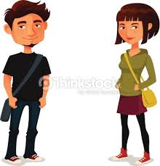

Solution 1: Classification Model
Use features of both products as well as users in order to predict whether a user will like a product or not.
User Features
(Eg. Age, Gender)
Product Features (Eg. cost, quality)
Purchase History
Classifier
Limitations.
It is difficult to collect high quality information about products and users.
Like/Not like
Notes:
Use features of both products as well as users in order to predict whether a user will like a product or not.

Slide 16
Quiz
Which of the following is true of a Classification model based recommender system?
Can generate Personalized Recommendations?
Can use Context (Eg. time of day)?
Can use User Features?
Can use Item Features?
Can use Purchase History?
Is it Scalable?

Slide 17
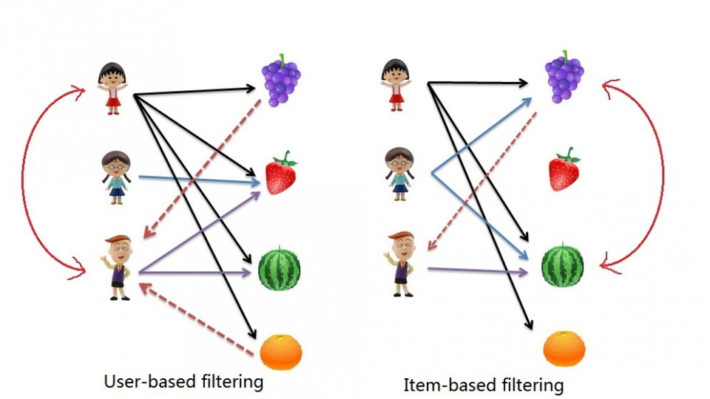
Solution 2: Nearest neighbor Collaborative Filtering
User-based Collaborative Filtering
Find users who have
a similar taste of products
as the current user.
Similarity is based upon
similarity in users’
purchasing behaviour.
“User x is similar to user y
because both purchased
items A, B and C.”
Item-based Collaborative
Filtering
Recommend items that are
similar to the items the user
bought.
Similarity is based upon
co-occurence of purchases.
“Items A and B were
purchased by both users
x and y, so they are similar.”
Fig. Source:
http://www.salemmarafi.com/code/collaborative-filtering-with-python/

Slide 18
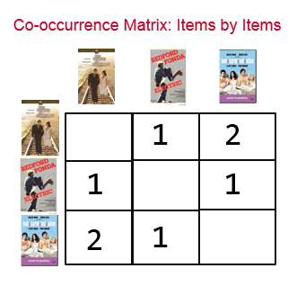
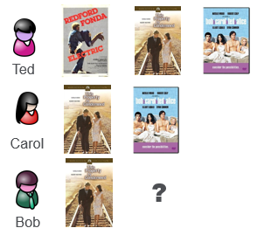
Item-based Collaborative Filtering: An Example (People who bought this also bought)
History Matrix
B
A
C
A
B
C
A
C
A
B
A
Example source:
https://www.mapr.com/blog/inside-look-at-components-of-recommendation-engine
C
Bob’s Recommendations= [C, B]

Slide 19

Item-based Collaborative Filtering: Effect of popular items
B
A
C
A
B
C
A
C
A
100,000
B
A
C
Notes:
IF everybody has watched Titanic, then it is not a very good indicator of what to recommend next, then the recommender would become similar to a popularity based recommender engine.

Slide 20
Item-based Collaborative Filtering: Normalize co-occurence matrix
Normalize by Popularity
Jaccard similarity
-Number of users common for i and j
Number of users for either i or j
A
B
C
A
100,000
3
2
100,002
B
3
2
C
3
2
Notes:
IF everybody has watched Titanic, then it is not a very good indicator of what to recommend next, then the recommender would become similar to a popularity based recommender engine.

Slide 21
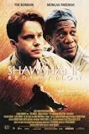

Item-based Collaborative Filtering: Effect of multiple items
Rows from normalized co-occurence matrix
B
A
C
A
B
C
D
A
0 | 0.33 | 1 | 0.5
0.25 | 0.25 | 0 | 0.2
A
C
D
Weighted sum=
(Scores for movie A
+ Scores for movie D)/2
0.125 | 0.29 | 0.5 | 0.35
A
D
C
D
B
A
Ranked
Recommendations:
0.5 | 0.35 | 0.29 | 0.125

Slide 22
Quiz
Given a user x itemRatings matrix of size 480,189 x 17,770, which model will you apply given the matrix is very sparse?
Popularity based recommender system
Classification model based recommender system
Item similarity based recommender system
User similarity based recommender system
All of the above
None of the above
May be

Slide 23
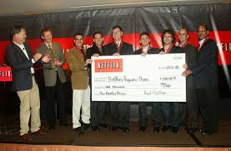
480,189 x 17,770
This is the Million Dollar Matrix!!!!$$$$$$!!!!
~100 million ratings
Only 100 million out of possible 8.5 billion ratings are non zero.
Very sparse matrix!
Notes:
~100 million ratings….what if all the data is stored in memory
This matrix has nearly 8Billion entries (8.5 billion),
Out of which only 100M are non zero ratings

Slide 24
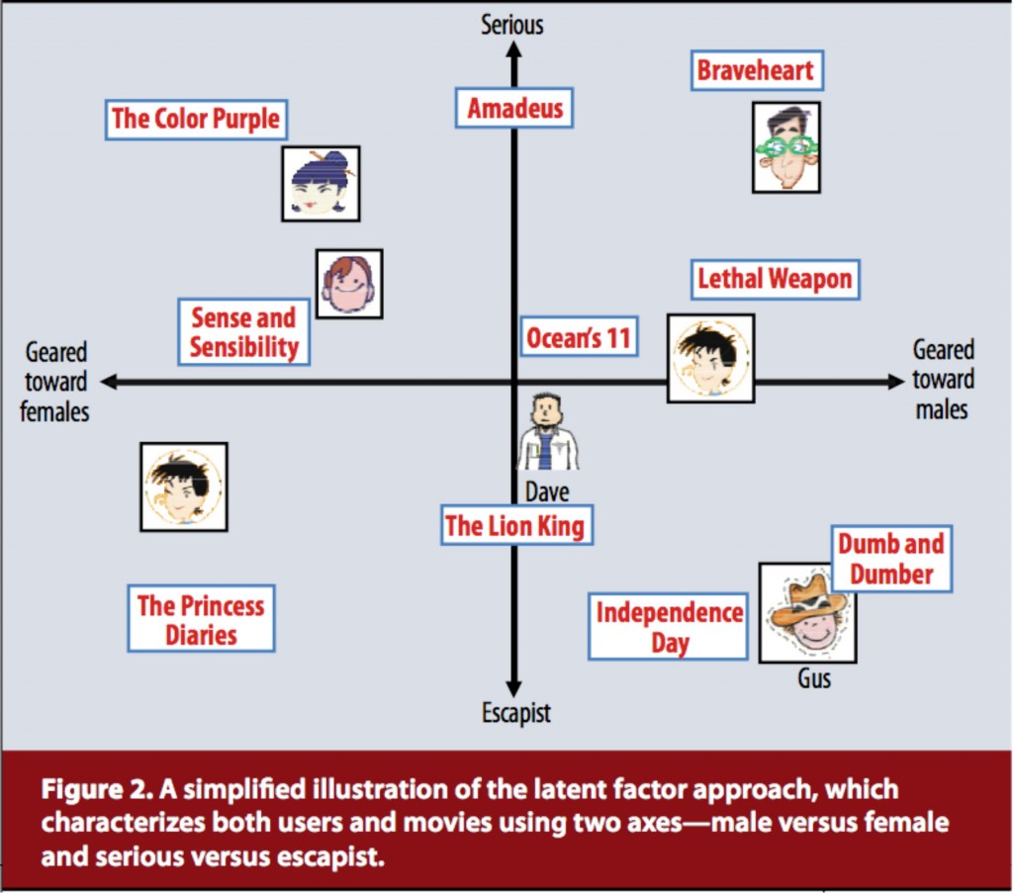

Solution 3:
Model based Collaborative Filtering (Matrix Factorization)
Identify latent (hidden) features from the input user x itemRatings matrix to represent users and items as vectors in N dimensional space.
(Serious/Escapist?) Geared towards Males or Females?
User Vector (u) = [1.3 2.8]
Item Vector (v) = [2.5 -1.9]
New user (Known ratings): [4 5 ….3]
Netflix Prize diagram (Koren et al., 2009)
Koren, Yehuda, Robert Bell and Chris Volinsky. 2009. “Matrix Factorization Techniques for Recommender Systems.” Computer 42:8.
Notes:
The probability that two users who have bought 100 books each have a common book assuming that there is a catalog of million books is 0.01
The Netflix competition which was completed in 2009, showed that many matrix factorization based methods could be used for solving the problem of recommender systems.
Decompose users and movies in to a set of latent factors
Predicted Rating
(User Vector . Item Vector) = [3.7 2.5 ….. 5.3]
Fig source:
http://spark-mooc.github.io/web-assets/images/matrix_factorization.png

Slide 25
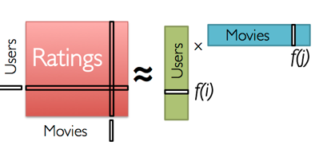
Solution 3:
Model based Collaborative Filtering (Matrix Factorization)
Training: Use Matrix factorization approaches (Eg. Singular value Decomposition or SVD) to split the Rating Matrix into constituent User Matrix and Item Matrix with minimum Sum of squared error (SSE).
The winning entry for the famed Netflix Prize had a number of SVD models including SVD++ blended
with Restricted Boltzmann
Machines. Using these methods they achieved a 10 percent increase in accuracy over Netflix’s existing algorithm.
--Gower 2014
SVD:
A_{nxp}= U_{nxn} S_{nxp} V^{T}_{pxp}
Goal: Predict unknown ratings for the remaining set of movies using the learned User Matrix and Item Matrix
Refer to Gower 2014 to read more about Netflix prize and SVD (Gower, Stephen. "Netflix Prize and SVD." (2014): 1-10.)
Notes:
The probability that two users who have bought 100 books each have a common book assuming that there is a catalog of million books is 0.01
The Netflix competition which was completed in 2009, showed that many matrix factorization based methods could be used for solving the problem of recommender systems.
Decompose users and movies in to a set of latent factors
Predicted Rating
(User Vector . Item Vector) = [3.7 2.5 ….. 5.3]
Fig source:
http://spark-mooc.github.io/web-assets/images/matrix_factorization.png

Slide 26

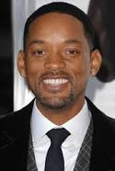
Performance Metric for Recommendation Systems
All Recommendations (made on training dataset)
Relevant Items
that are also
recommended
Irrelevant Items that are
recommended
All
Relevant
Items
(All items
in the
test set)
Relevant items that are not
recommendations
Precision = # of products relevant & recommended / # of items recommended
(Measure of exactness)
Recall = # of products relevant & recommended / # of relevant items
(Measure of completeness)
Notes:
Relationship between Precision Recall and ROC curves:
Davis, Jesse, and Mark Goadrich. "The relationship between Precision-Recall and ROC curves." Proceedings of the 23rd international conference on Machine learning. ACM, 2006.

Slide 27
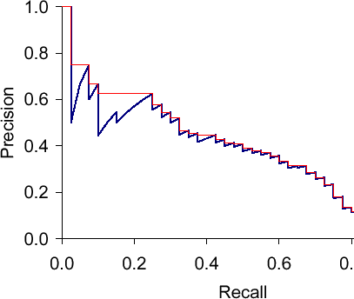
Performance Metric for Recommendation Systems
Precision Recall Curve: Evaluation of top n recommendations
Notes:
Relationship between Precision Recall and ROC curves:
Davis, Jesse, and Mark Goadrich. "The relationship between Precision-Recall and ROC curves." Proceedings of the 23rd international conference on Machine learning. ACM, 2006.

Slide 28
Performance Metric for Recommendation Systems
Some other metrics
Mean Absolute Error
Accuracy
ROC curve
Gunawardana, Asela, and Guy Shani. "A survey of accuracy evaluation metrics of recommendation tasks." Journal of Machine Learning Research10.Dec (2009): 2935-2962.
Notes:
1)The mean absolute error (MAE) is a measure of the deviation of recommendations from their true user-specified values.
2)

Slide 29

Quiz: Comparison of Recommendation Systems
Cold Start Problem!
Which recommender model can handle brand new items
(Eg., a new released movie)?
 | Popularity Based | Classification Based | (Nearest Neighbor-based CF) | (Matrix Factorization based CF)
Personalized Recommendations
Uses Context (Eg. time of day)
User Features
Item Features
Purchase History
Scalable
Can handle brand new Items?

Slide 30

Music Recommendation
(Python notebook)
Notebook:
https://github.com/dvysardana/RecommenderSystems_PyData_2016
Short url:
https://goo.gl/kVnNKf

Slide 31
Resources
Book: Recommender Systems An Introduction by Dietmar Jannach
Book: Mining Massive Datasets by Jure Leskovec, Anand Rajaraman, Jeff Ullman (www.mmds.org)
Coursera course on Recommender Systems, by University of Washington
Coursera course on Recommender Systems, by University of Minnesota

Slide 32

Do you have
any questions?

